Slide 2
JUMBLED WORDS

Slide 3
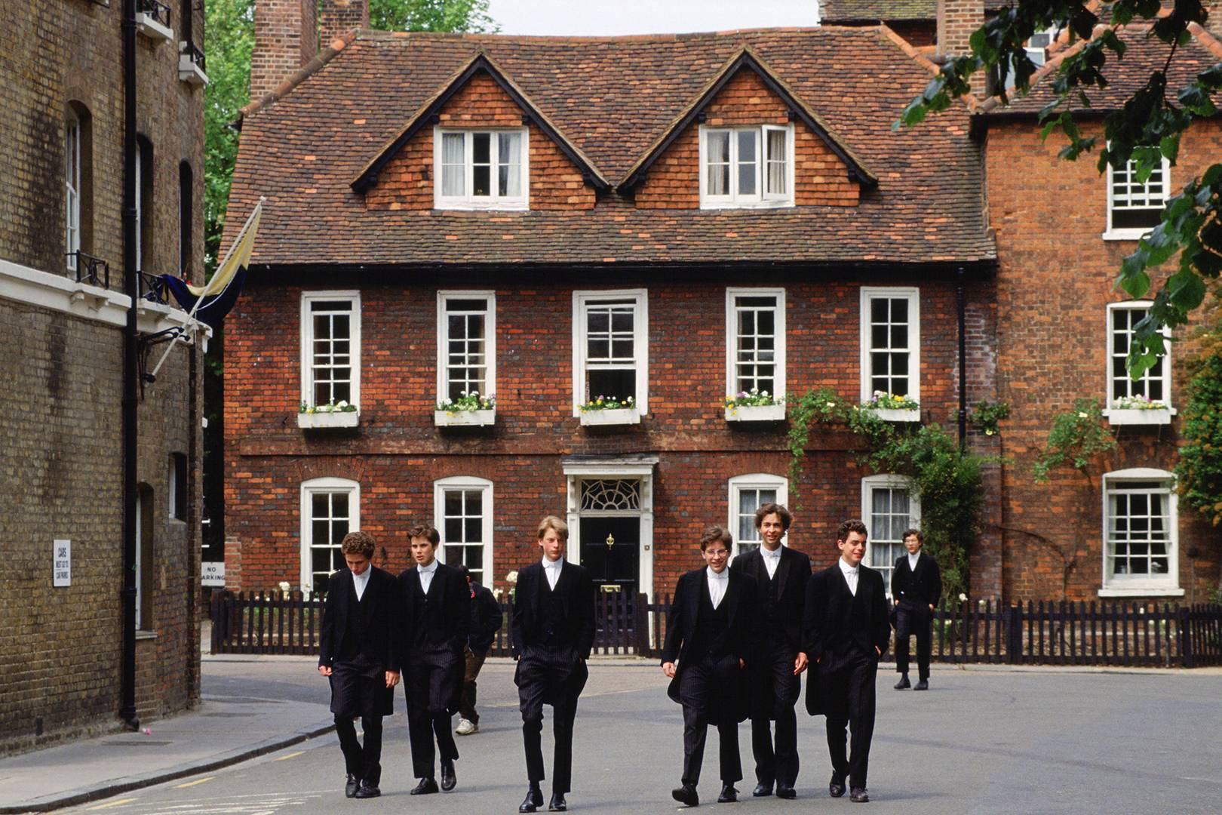
ORGANBID CLOHOS
BOARDING SCHOOL

Slide 4
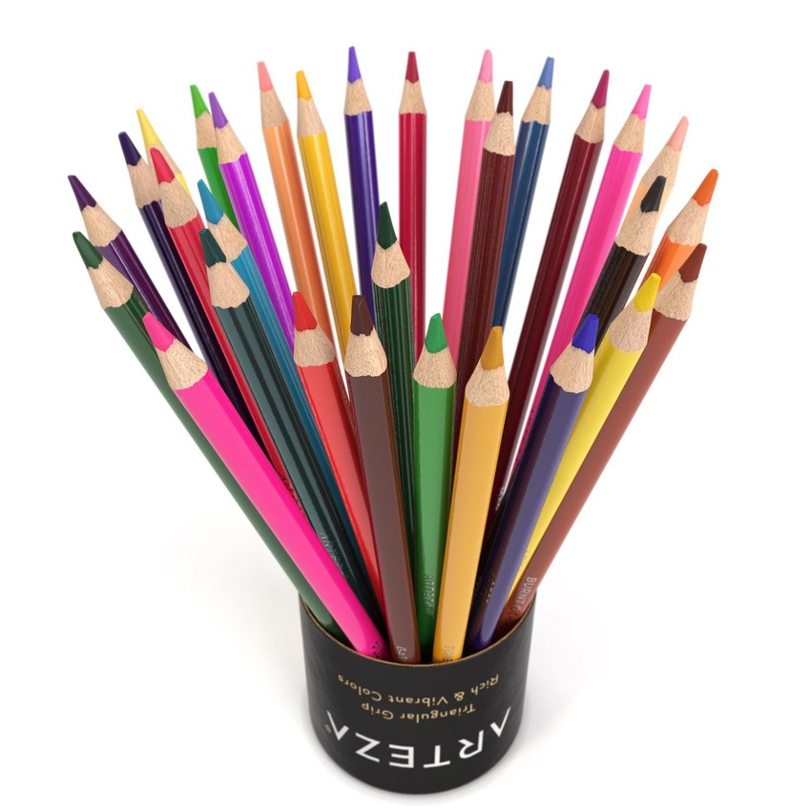
DROLOCE SNILPEC
COLORED PENCILS

Slide 5
GYRAOGHEP
GEOGRAPHY

Slide 6
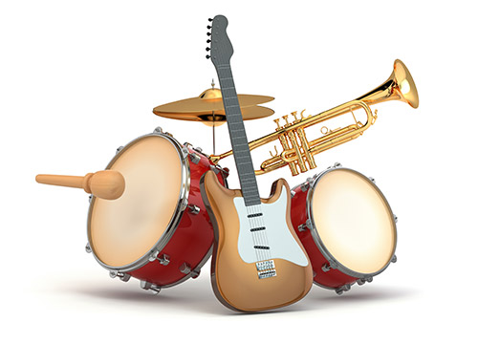
SCAILUM TERNSIMSUNT
MUSICAL INSTRUMENTS

Slide 7
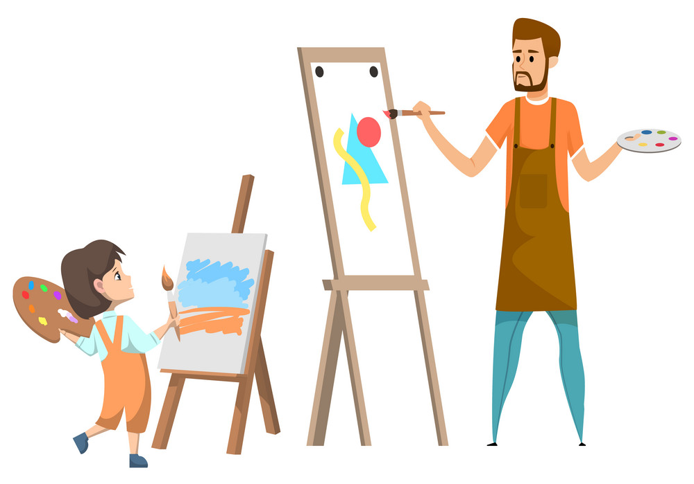
TAR HEATCER
ART TEACHER

Slide 8
Homework
HMRMOODE

Slide 9
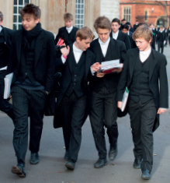
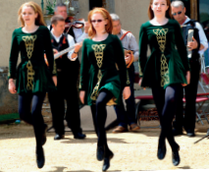
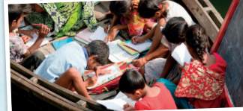
What are they wearing?
What are the people doing?
➔ They’re wearing school uniforms.
➔ They’re dancing.
Is the boat moving?
➔ No. The boat isn’t moving.

Slide 10
They’re wearing school uniforms.
They’re dancing.
The boat isn’t moving.
PRESENT CONTINUOUS TENSE

Slide 11
UNIT 4: learning world
Lesson 3: language focus – present continuous : affirmative and negative

Slide 12
PRESENT CONTINUOUS TENSE
We use Present Continuous Tense to talk about things happening now.
( + ) :
S + am / is / are + V_{ing} + O?
Ex: They are watching TV now.
(= They’re)
I am doing my homework.
(= I’m )

Slide 13
( - ) :
S + am / is / are + NOT + V_{ing} + O?
Ex: I am not listening to music at the moment.
(= I’m not )
Ex: He is not studying English now.
(= He isn’t )

Slide 14
SPELLING RULES
1) Most verbs : + -ing
study → studying eat → eating
2) Verbs ending in e: remove e + -ing
move → moving take → taking
3) Verbs ending in vowel + consonant: double final consonant + -ing
chat → chatting plan → planning

Slide 15
Complete the examples from the text on page 50. Then choose the correct words in Rules 1–3
1) These students _______studying. 2) The boat _________moving. 3) Her students ___________at home and _________the lessons on television. 4) I’m __________the dancers.
are
isn’t
are staying
learning
watching

Slide 16
1) The present continuous talks about things
happening now
/ a routine.
2) We form the present continuous with the verb
be
/ do.
3) We add
to the main verb.
-s /
-ing

Slide 17
What are the present continuous forms of verbs 1–5? Read the Spelling Rules and match the verbs to Rules 1–3.
1) wear 2) have 3) do
wearing
(rule 1)
having
(rule 2)
doing
(rule 1)
4) dance 5) sit
dancing
(rule 2)
sitting
(rule 3)

Slide 18
Listen to the sounds. Match the people in column A with the actions in column B

Slide 19
1) A young child | a) (watch) TV.
2) Two women | b) (have) a dinner.
3) Two men | c) (run) in the park.
4) A girl | d) (speak) to his mother.
5) A boy | e) (look) for a mosquito.
6) A man | f) (play) a musical instrument.

Slide 20
WRITE SENTENCES USING THE PRESENT CONTINUOUS
(TASK 3/ P.51)

Slide 21
1. A young child is speaking to his mother. 2. Two women are running in the park.
3. Two men are having dinner. 4. A girl is playing a musical instrument. 5. A boy is watching TV. 6. A man is looking for a mosquito.

Slide 23
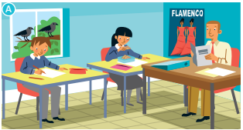
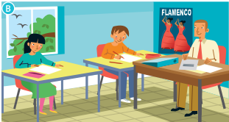
Find six differences between the pictures. Write three affirmative and three negative sentences about picture B. Use the present continuous.

Slide 24
Find six differences between the pictures. Write three affirmative and three negative sentences about picture B. Use the present continuous.
1) The boy is sitting next to the teacher. 2 The birds are flying. 3 The people on the poster are dancing. 4 The teacher isn’t reading. 5 The girl isn’t eating. 6 The students aren’t wearing uniforms.

Slide 25
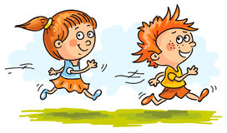
WHO IS the best?

Slide 26
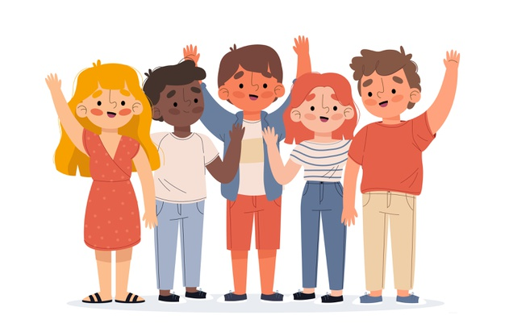
Make a mini-dialogue with the situations in the box or your own ideas.

Slide 27
come to my house / have lunch with … / teach me to … go to the cinema / chat with … / talk about … go shopping / visit … / show me … … ? / … ? / … ?

Slide 28
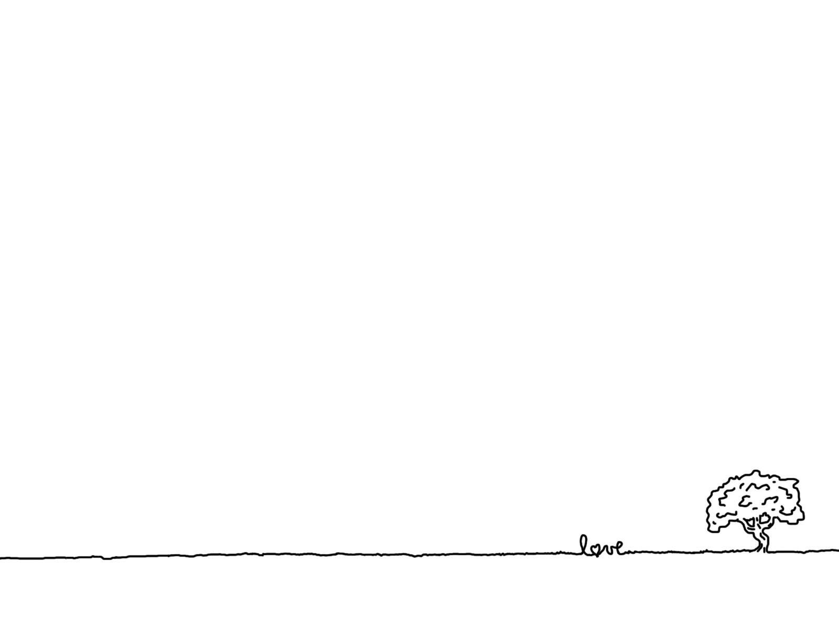
Homework
- Learn by heart new structures.
- Prepare the next lesson: VOCABULARY AND LISTENING

